Slide 1
Web Designing
By Jefrey Arias

Slide 2
The Projects I have work on
1- My first website
2- Macbeth Act
3- The Fiddler on the roof slide show
4- Photo Contest
5- CSS Layouts

Slide 3
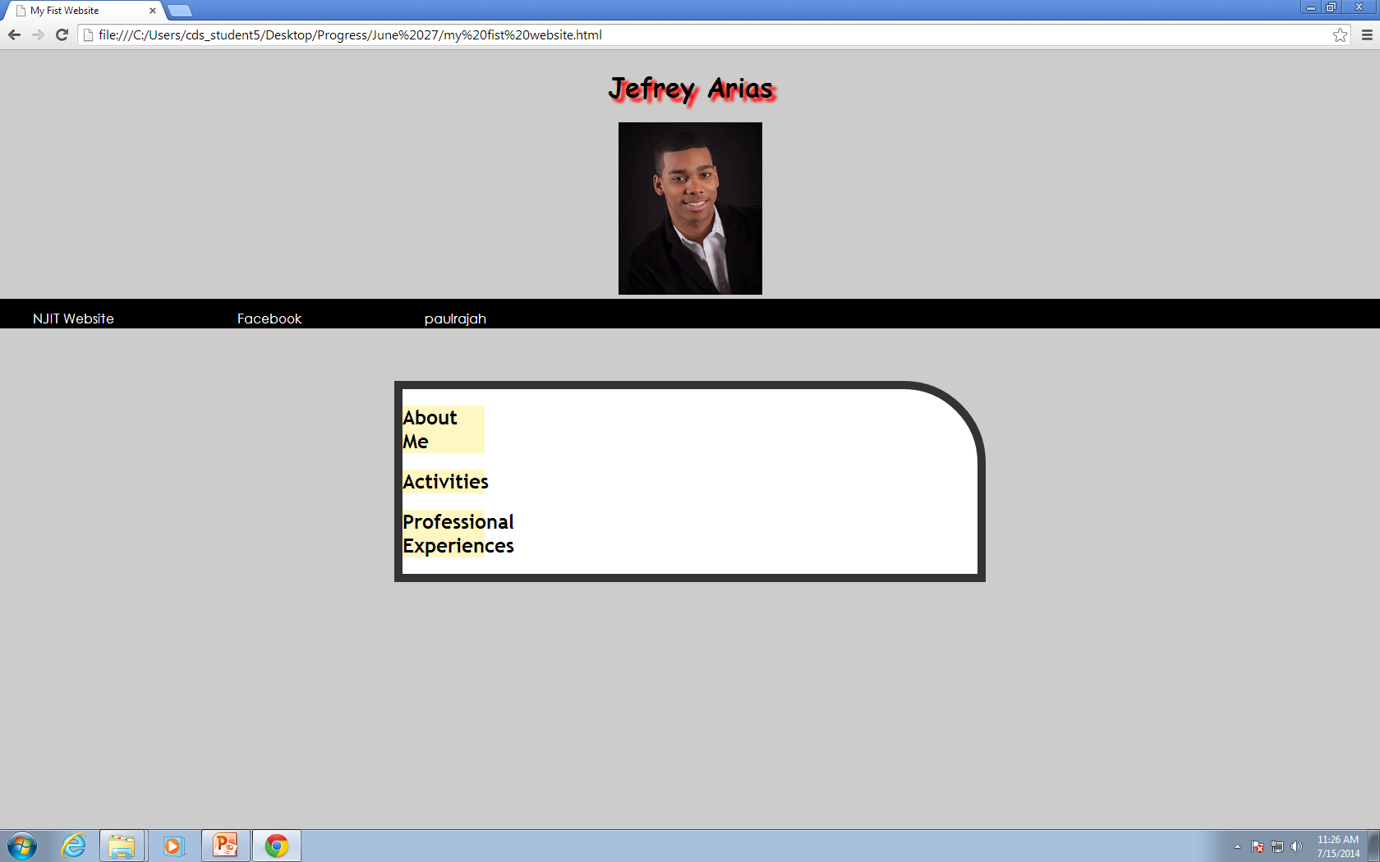
My First Website

Slide 4
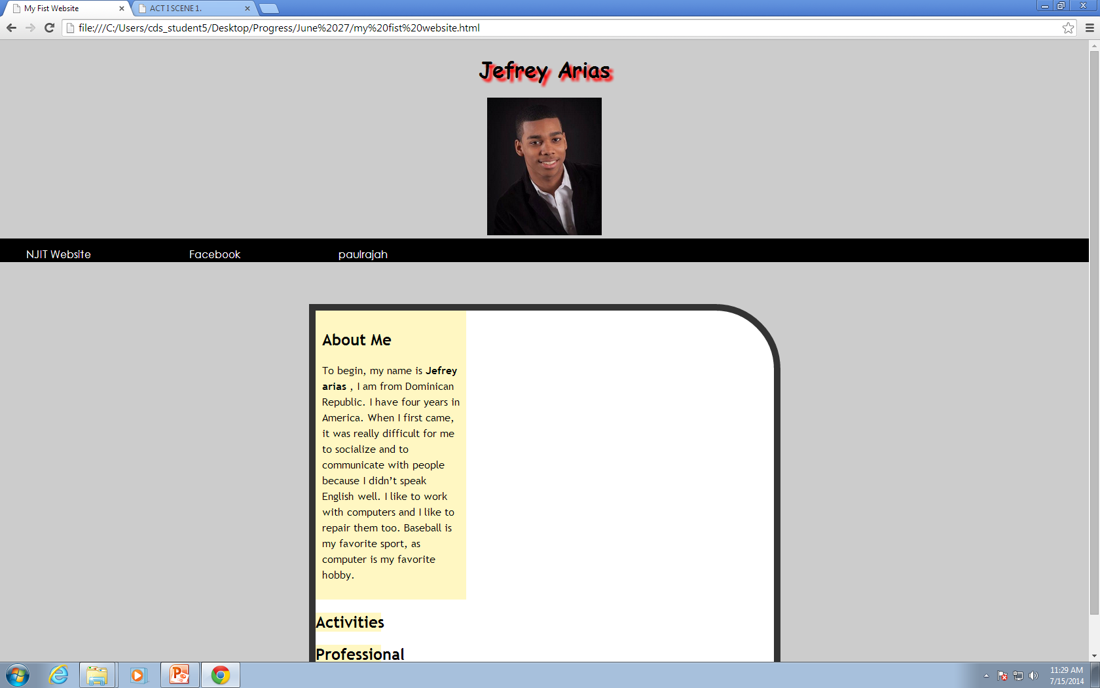

Slide 5
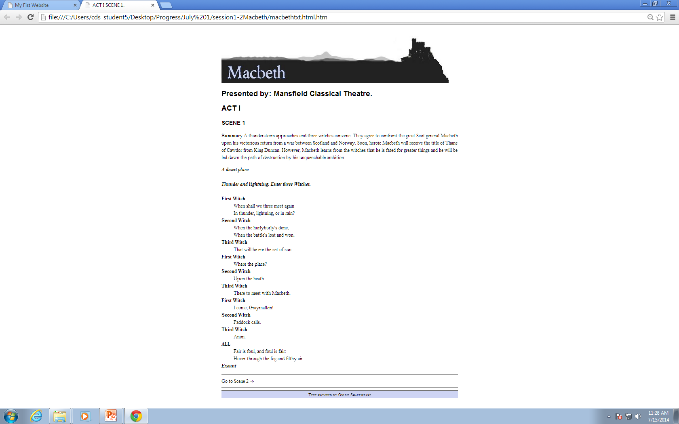
The Macbeth Act

Slide 6
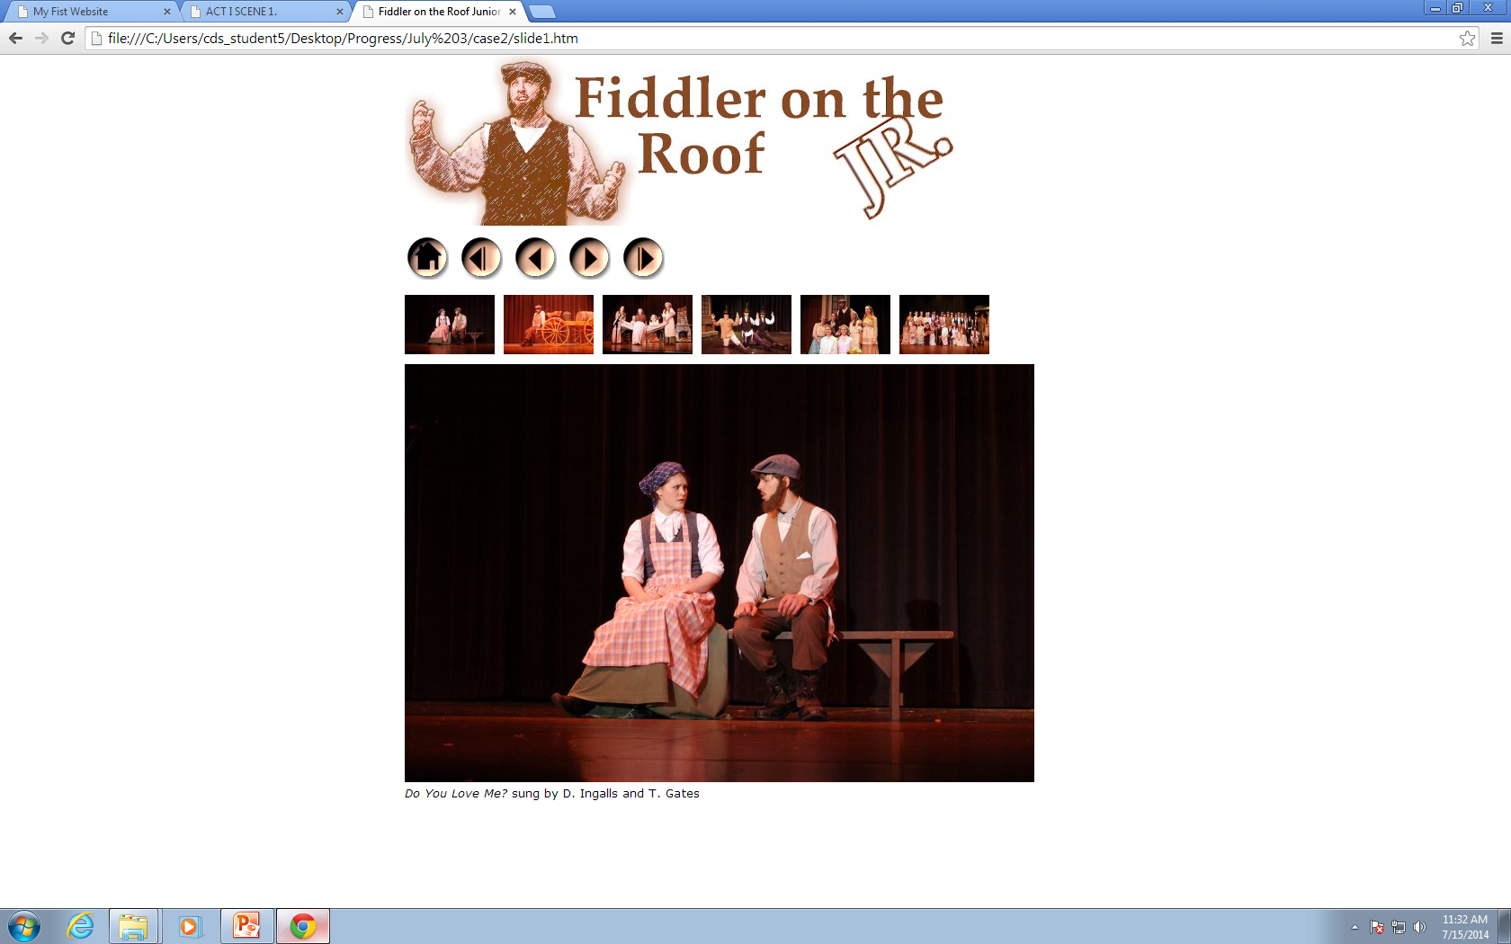
The Fiddler on the roof slide show

Slide 7
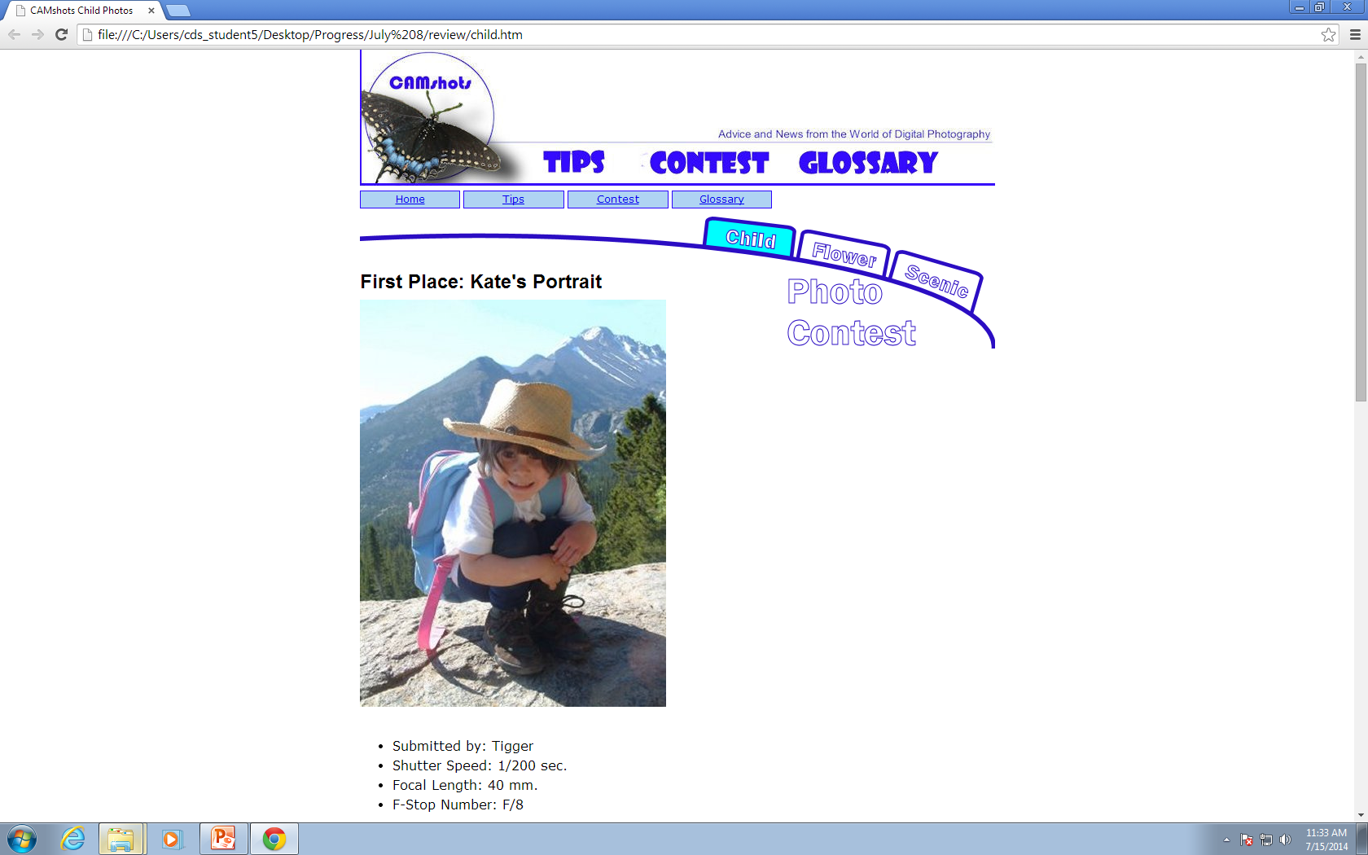
Photo Contest

Slide 8
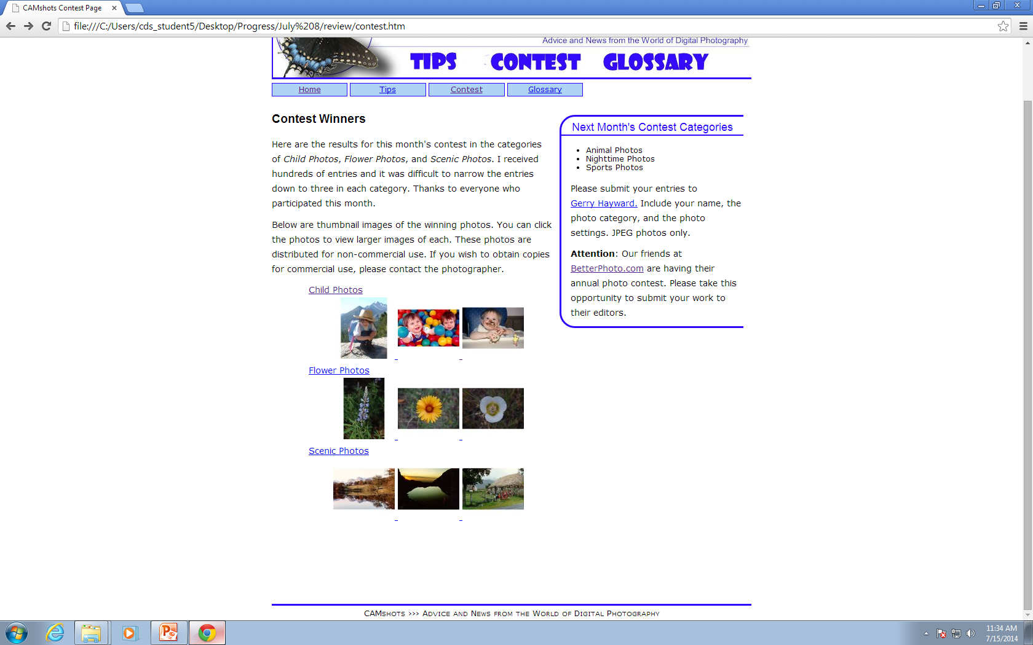

Slide 9
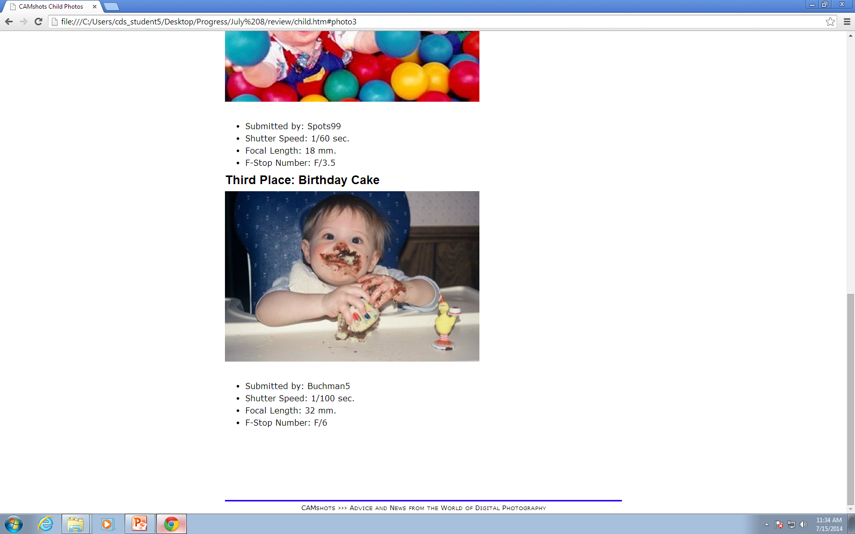

Slide 10
CSS Layouts
There were five layouts to be work on.

Slide 11
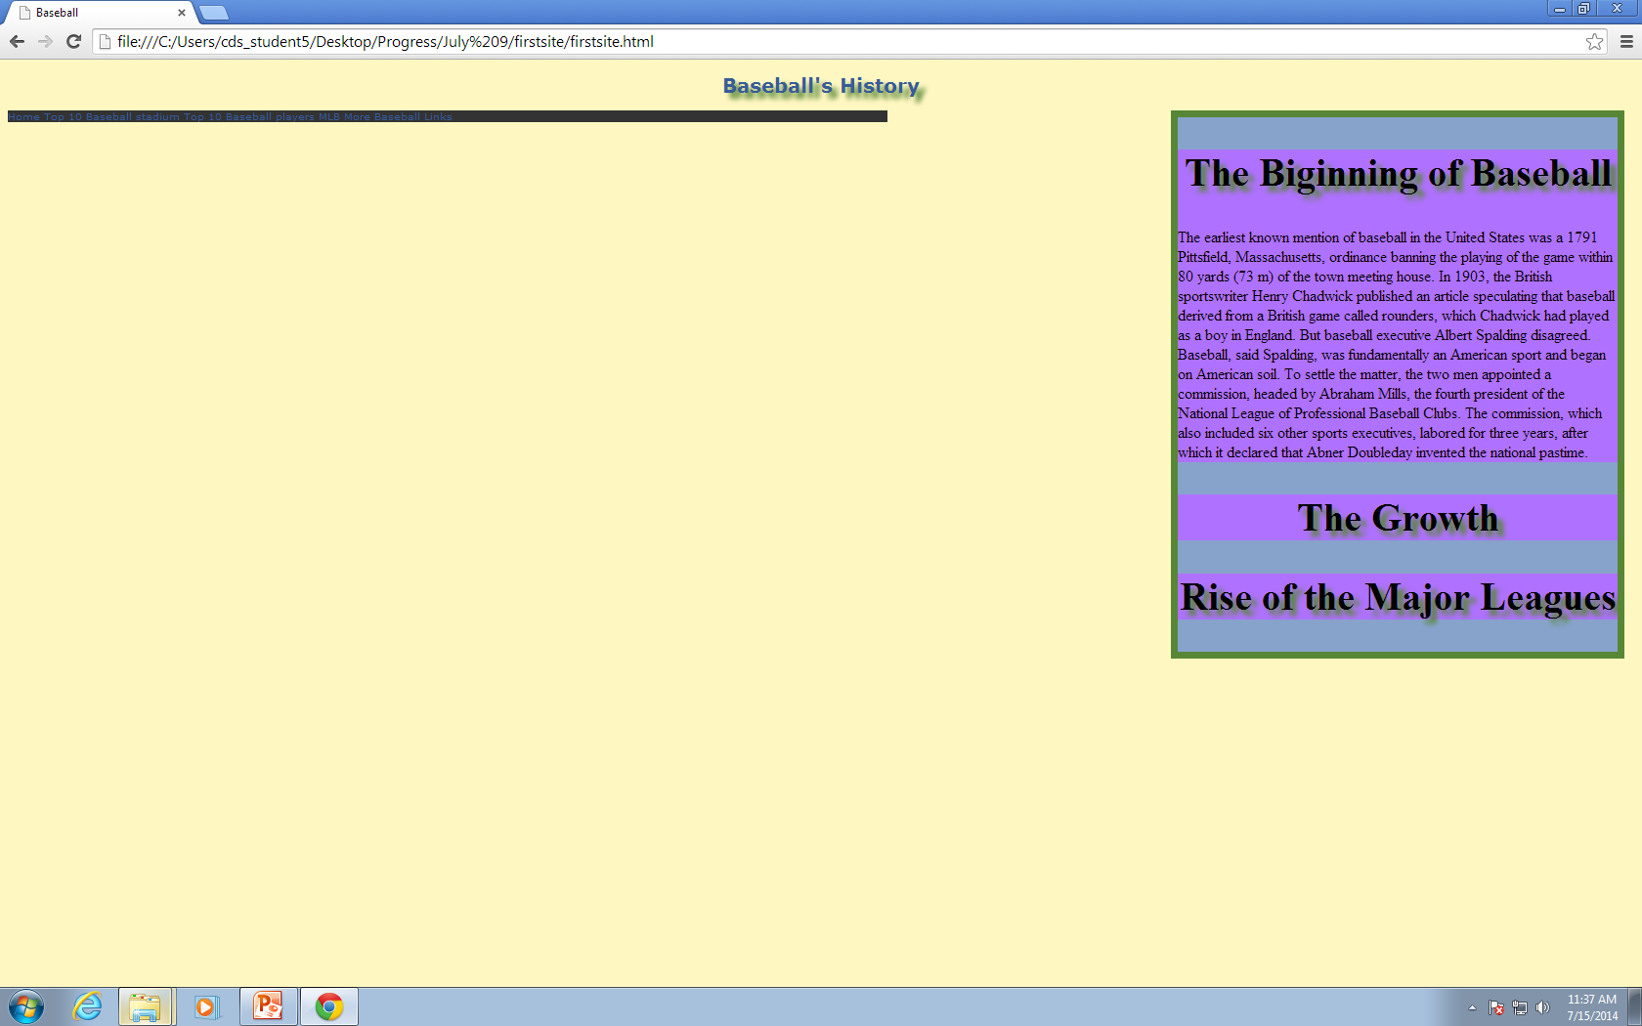
First

Slide 12
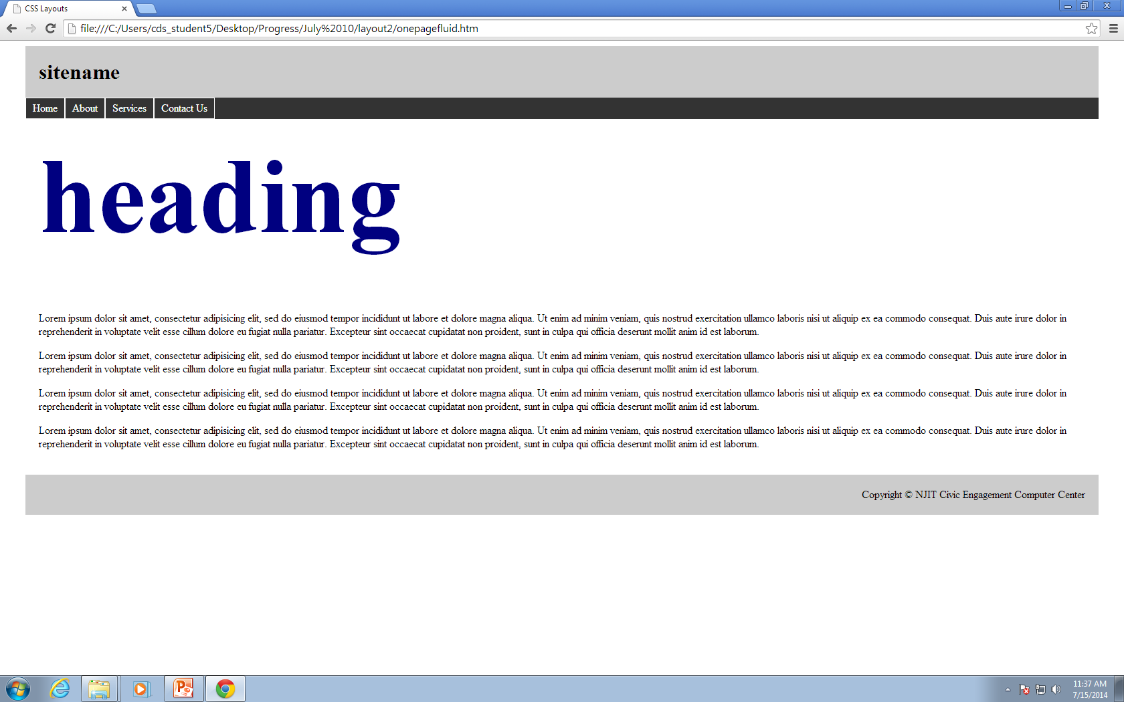
Second

Slide 13
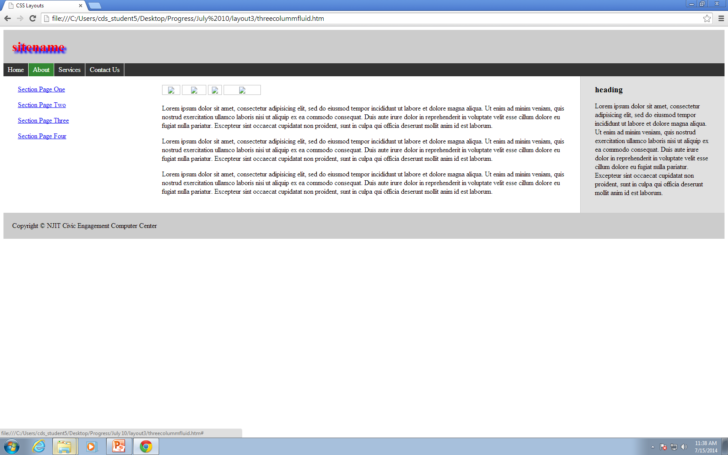
Third

Slide 14
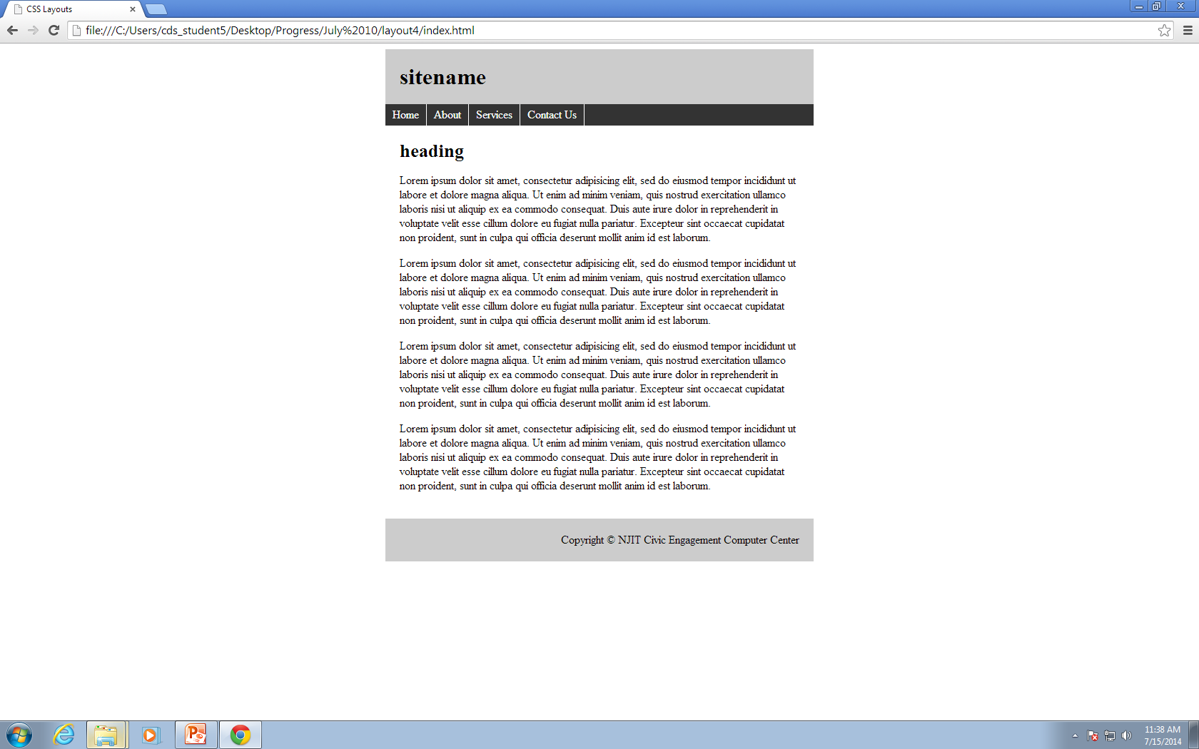
fourth

Slide 15
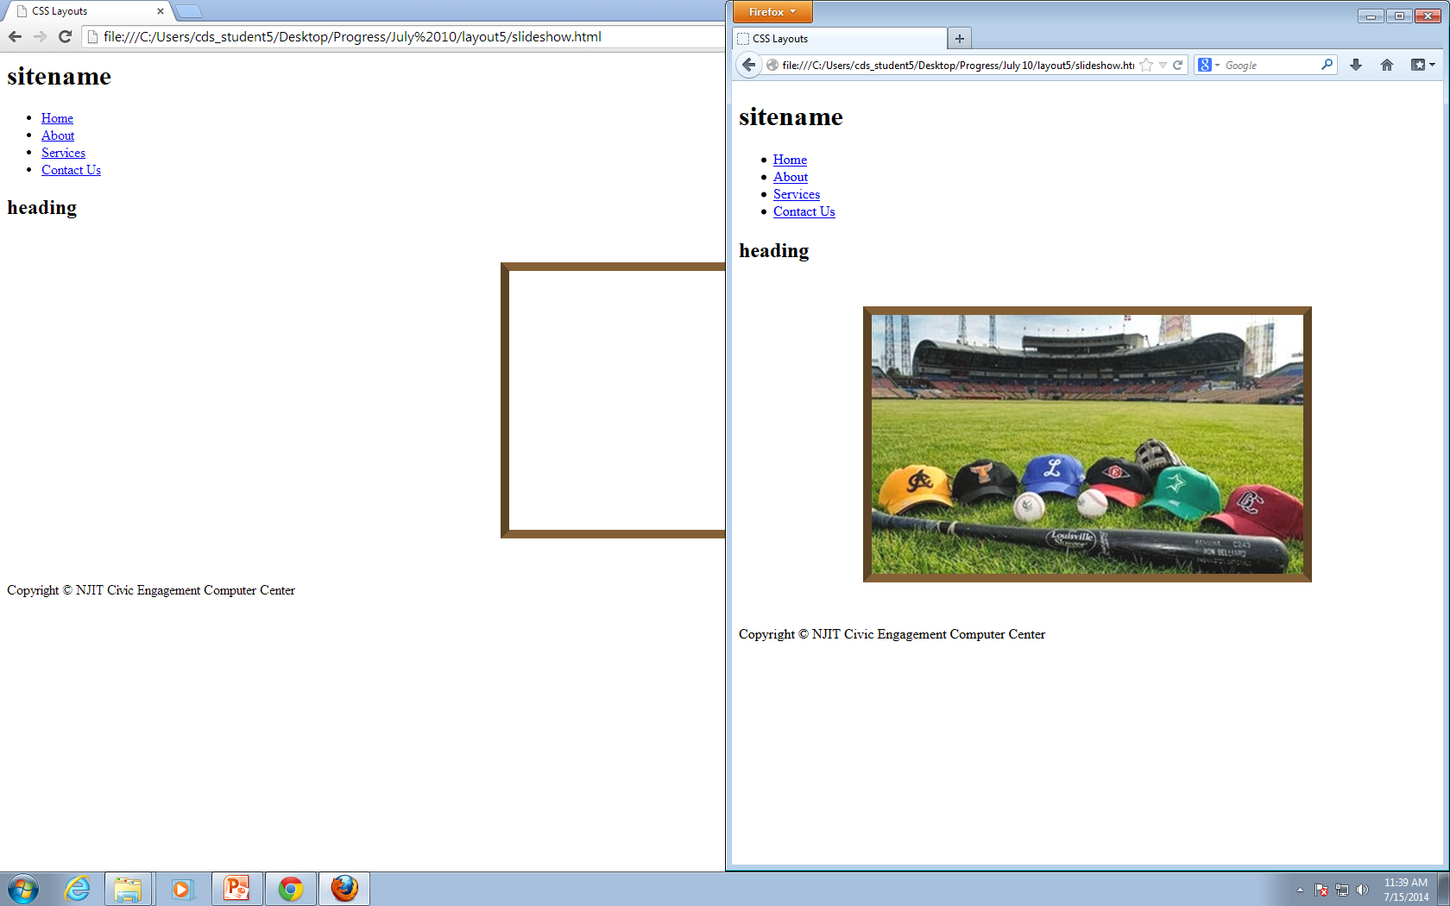
fifth

Slide 16
Questions
When did web develop started?
What are the most important tags in html?
How many html tags are?
Who created html?
What other uses does html has?

Slide 17
Concerns
I believe there are no concerns about this internship,

Slide 18
What I expect to learn
What I expect to learn is how to create a website that looks equal or better then the other ones in the internet, and I want to be able to develop any website without having trouble with tags.

